Slide 1
Career Exploration
Kyle Keller and Randi Lewis-Mohler
Career Advisors
Sinclair Community College

Slide 2

Question:
How many students are enrolled in Sinclair College?
A. 14,600
B. 34,000
C. 9,000
D. 126,000

Slide 3
Answer:
B. 34,000
More than Wright State University and University of Dayton Combined.

Slide 4

Question:
What percentage of all jobs require some form of postsecondary education according to American Public Radio?
A. 30%
B. 40%
C. 50%
D. 60%

Slide 5

Answer: D
60% of all jobs require some form of postsecondary education.

Slide 6

Question:
On average, how much more do people with a bachelor’s degree earn compared to those with a high school diploma?
A. $13,000
B. $10,800
C. $17,500
D. $8,000

Slide 7
Answer:
C. 17,500
College graduates aged 25 to 32 who are working full time earn about $17,500 more annually than their peers who have only a high school diploma

Slide 8

Question:
What percentage of students change their major at least one time before they graduate?
A. 30-40%
B. 50-70%
C. 80-90%

Slide 9

Answer: B
Studies show anywhere from 50-70% of students change their major at least one time before they graduate. Many will change as many as 3 times!

Slide 10

Reasons people choose a career field
Parents
Peer Pressure / Friends
Gender / Culture Roles
Previous Experience
Skills and Interest
A Career Assessment
The Media / News about Hot Jobs
Other?

Slide 11

Choose a career based off of your…
Skills (what can you do)
Interests (what you enjoy doing)
Values (what matters to you)

Slide 12

What are skills?
Things we learn in order to complete tasks. Each career field has specific necessary skills in order to be successful.
What skills are important in your industry?

Slide 13
Examples of skills:
Leading a group
Fighting fires
CPR / Administering First Aid
Public Speaking
Math
Building / Fixing Things
Writing
Drawing
Caring for Others
Teaching Others
Solving Problems
Others?

Slide 14

What are interests?
Something you enjoy
How you like to spend your time
Hobbies
Something that excites you
Things you enjoy reading about or learning more about
What interests you about your industry?

Slide 15
Examples of Interests:
The Environment
Cars
Helping Others
Animals
Science
Math
Music
Politics
Computers
Listening to Others
Other Cultures
Building Things
Traveling
Being Creative

Slide 16

What are values?
Things that:
Matter to you
You are passionate about
Are guiding principles / behaviors for your life
What values are important in your industry?

Slide 17
Examples of Values:
Helping Others
Making Money
Prestige
Work / Life Balance
Leading
Teaching
Justice
Independence
Flexibility
Short Commute
Religion
Family / Friends
Work Environment
Work Schedule

Slide 18
Career Assessments
Focus 2: www.sinclair.edu/focus2
Jung Typology (aka Myers Briggs): http://www.humanmetrics.com
Ohio Career Information Systems https://ocis.org (username: sinclaircoll, password: ohiocis03)

Slide 19
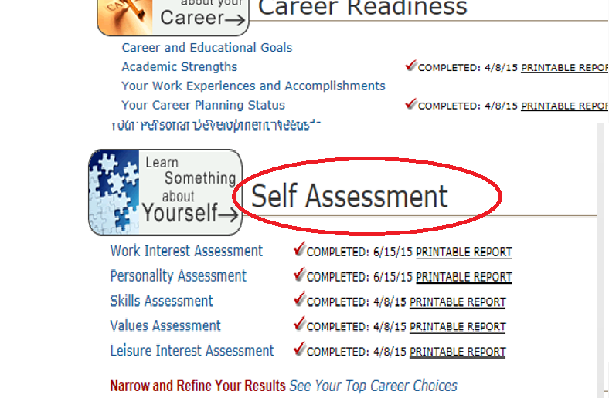
Focus 2: www.sinclair.edu/focus2

Slide 20
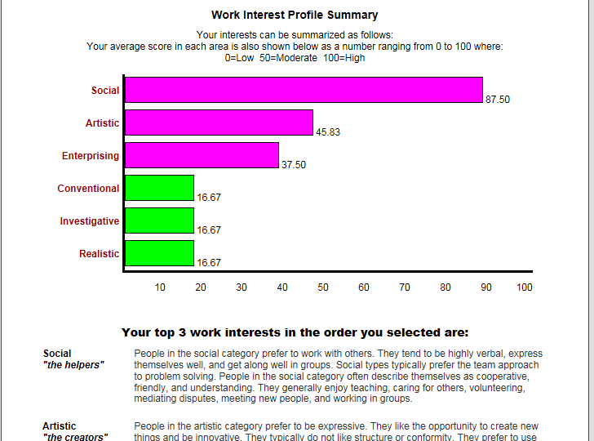
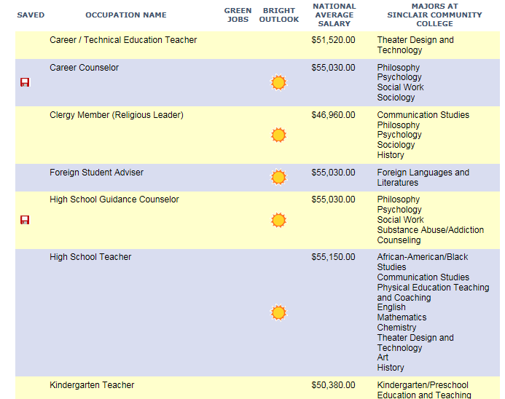
Focus 2: www.sinclair.edu/focus2

Slide 21
Research Careers
Visit various websites to learn more about your possibilities. Here are just a few!
Career Coach: www.sinclair.edu/careercoach
Occupational Outlook Handbook: http://www.bls.gov/ooh/
Ohio Career Information Systems: www.ohcis.intocareers.org
Username: sinclaircoll, Password: ohiocis03

Slide 22
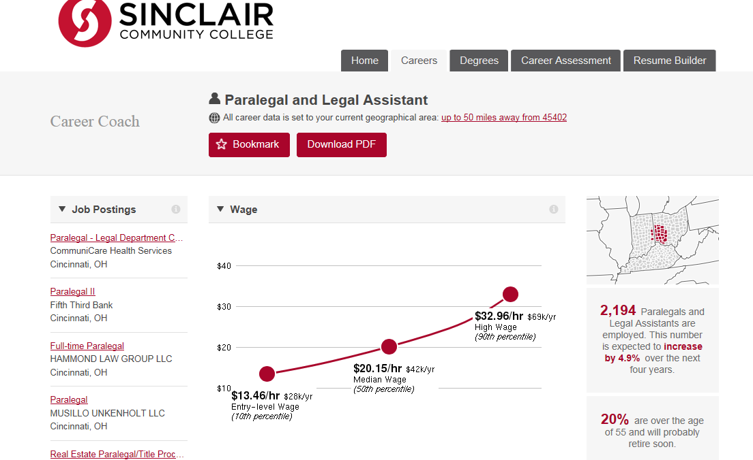
Career Coach: www.sinclair.edu/careercoach

Slide 23
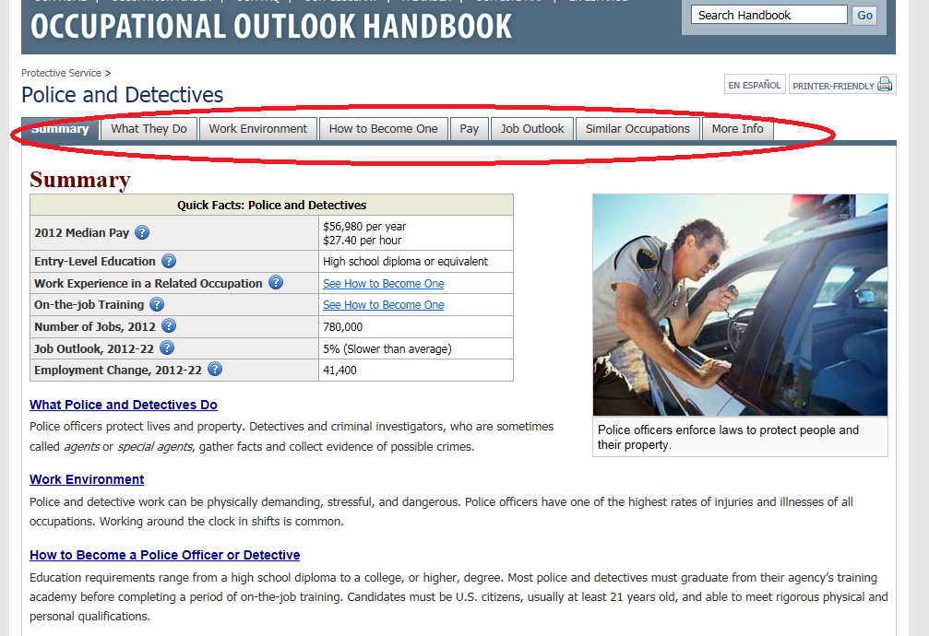
Occupational Outlook Handbook: www.bls.gov/ooh/

Slide 24
Experiential Learning
Chat with a Career Advisor / Guidance Counselor about your options
Meet with people who work in the field (also called an informational interview) to learn what it’s ‘really’ like
Job Shadow / Volunteer to see the day-to-day duties, environment, challenges and rewards
Watch videos on YouTube of people in your field
Talk to college professors about the field
Find a part time job, internship or volunteer in the field
Join clubs that are related to your field of interest

Slide 25

Steps to Career Exploration
1. Take assessments to help you figure out what your interests, skills and values are.
2. Research the careers that match your particular interests, skills and values.
3. Talk to people in the field / job shadow
4. Make a plan!

Slide 26

Crossfit Fails
https://www.youtube.com/watch?v=cVFiyeloNMY

Slide 27
Careers in Exercise Science
Athletic Training
Group Fitness Instructing
Health Educating
Physical Therapy
Outdoor Rec & Adventure
Facility & Event Operations
Cardiopulmonary Rehabilitation
Adapted Fitness
Personal Training
Biomechanics and Research
Strength and Conditioning
Nutrition
Exercise Physiologist
Mind/Body Wellness

Slide 28

Exercise Science at Sinclair
AAS
Exercise Science / AAS
  Articulation Agreements with UD and WSU for Sports Science
  Internship- about 15 hours per week
  Occupational Therapy Assistant
  Physical Therapy Assistant
AA / AS
  Physical Education / Sport & Recreational Management
  Liberal Arts / Associate of Science

Slide 29
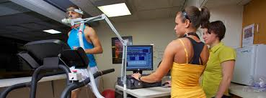
Where are our graduates?
Power Athlete
YMCA
Personal Training gyms
Kettering Medical Center
Maple Tree Cancer Institute
Kettering Sports Medicine
Own their own business
Crossfit gyms
Nursing homes

Slide 30
Meet with a Career Advisor
Kyle Keller and Randi Lewis-Mohler
Academic Advising Center
(937) 512-3700
Building 11, Room 346

