Slide 1


Tech Prep Student,
Throughout the rest of your high school career, you will have the opportunity to earn college credit for some of the work you are doing now. This credit, along with the opportunity to earn a scholarship, is awarded through Sinclair Community College.
This application is necessary for Sinclair to award college credit and very likely, a scholarship. It cannot be processed without a home address and social security number.
Completing this application does not obligate you to attend Sinclair upon graduation.
To make the application easier for you, we have provided an information sheet that you can complete prior to this application. If you have not received that sheet, please ask your career/technical teacher.
Please understand that this is an annual process for all students who are in the Tech Prep program (career/technical) in your school.
  +

Slide 2

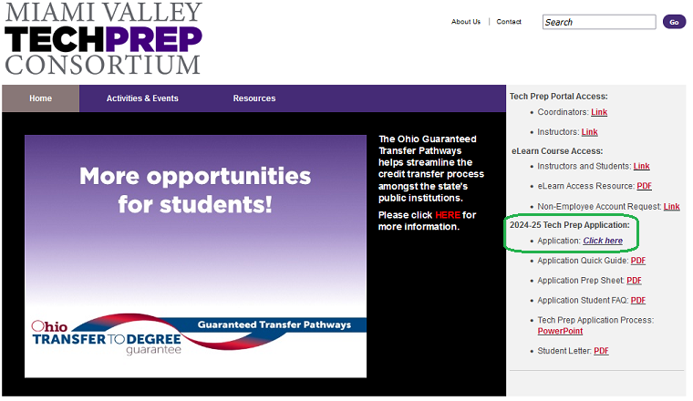
Getting Started
Open your browser and navigate to www.mvtechprep.org
Click Application: Click Here

Slide 3

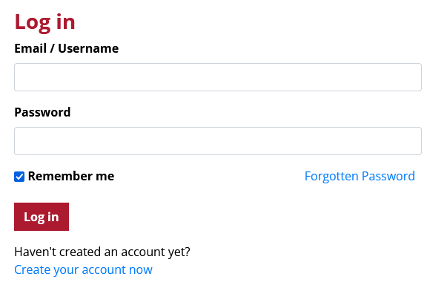
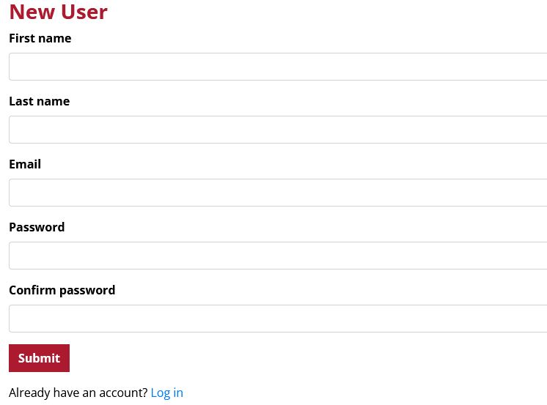
Click Create your account now
Enter your Legal first and last name
Use an email and password that you can easily access
Make the password something you can easily remember, you can change this later

Slide 4

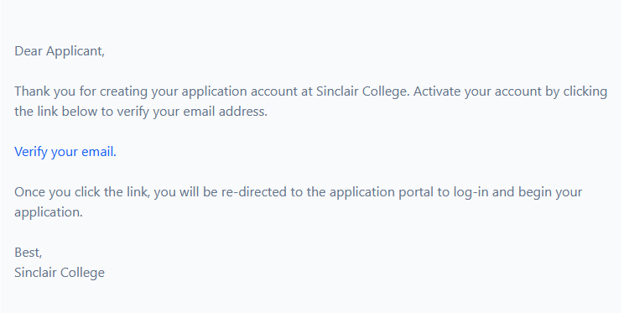

Check your email for the verification link.
Click Verify your email.
Once verified, click Log in to your account

Slide 5
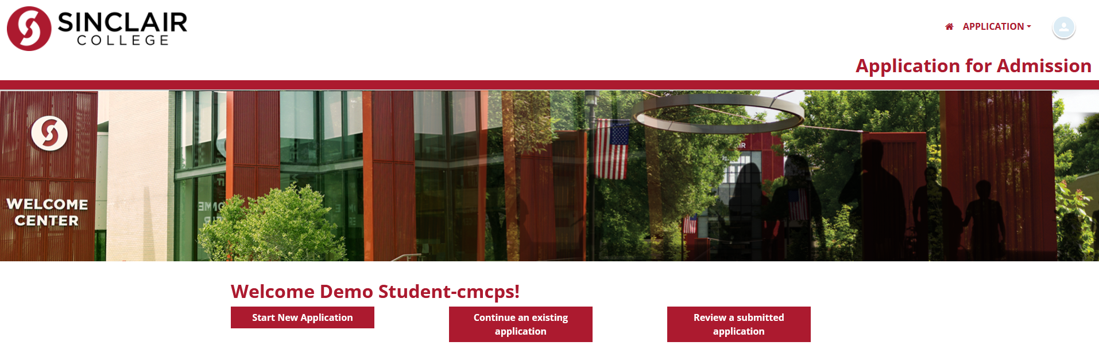
Log in with the credentials you provided earlier.
Click Start New Application

Slide 6
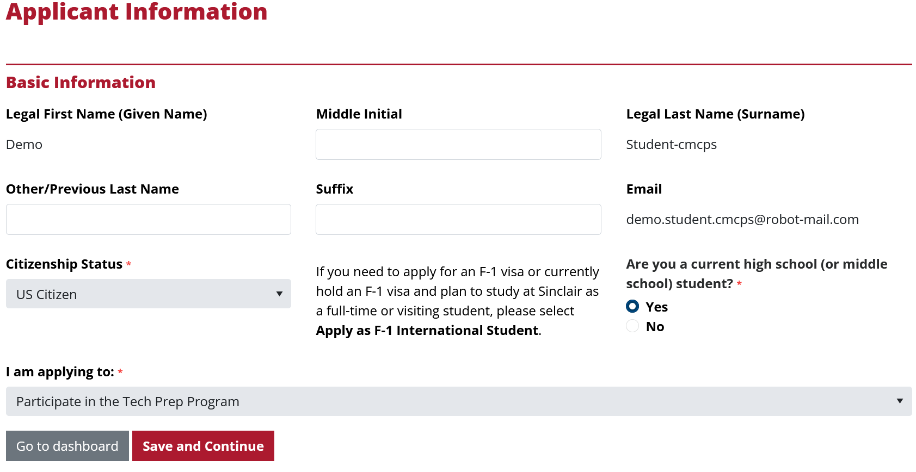
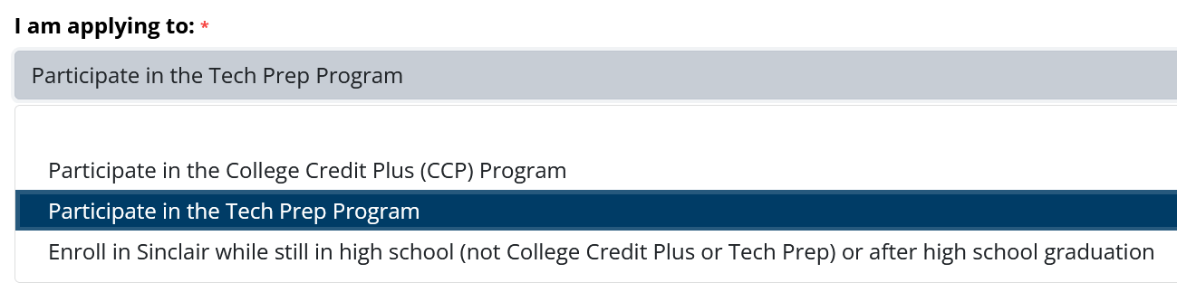
Your first and last name should automatically appear.
Go ahead and enter any other optional information. Note: a suffix is like Jr., Sr., II, III, etc.
Choose I am applying to Participate in the Tech Prep Program.
Click Save and Continue.

Slide 7
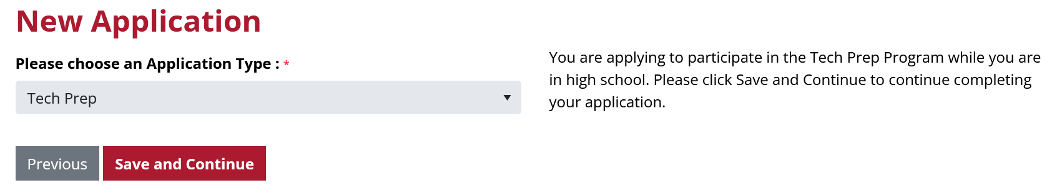
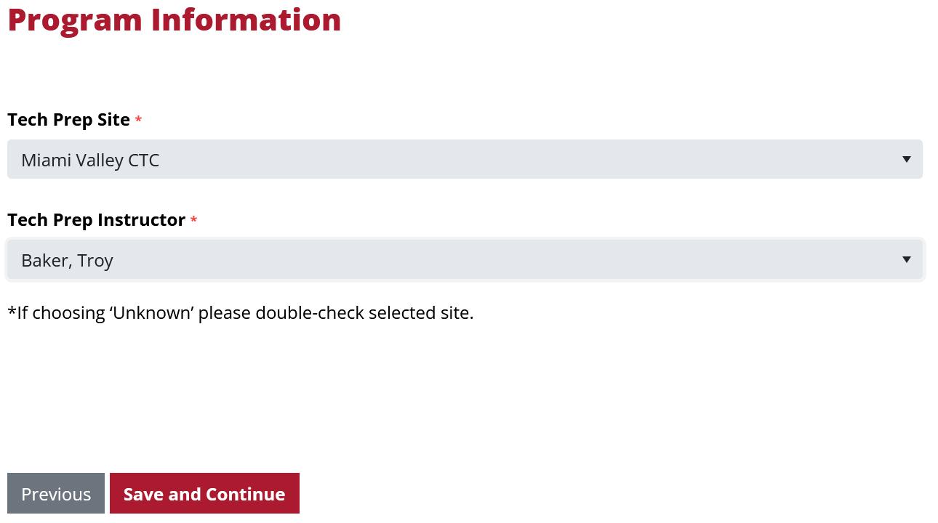
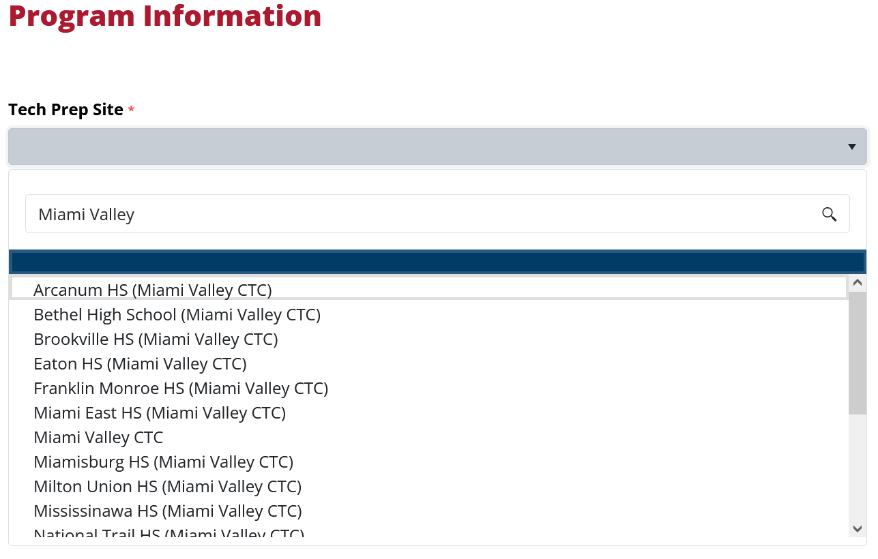
Since you are completing a Tech Prep application, no need to change this.
Click Save and Continue.
Select the school or career center where you are taking career tech courses. (Some schools have multiple campuses, so be careful to choose the right one!)
Select your instructor from the list.
(If your teacher does not show in the list, please raise your hand or let your teacher or a staff member know.)
Click Save and Continue.

Slide 8
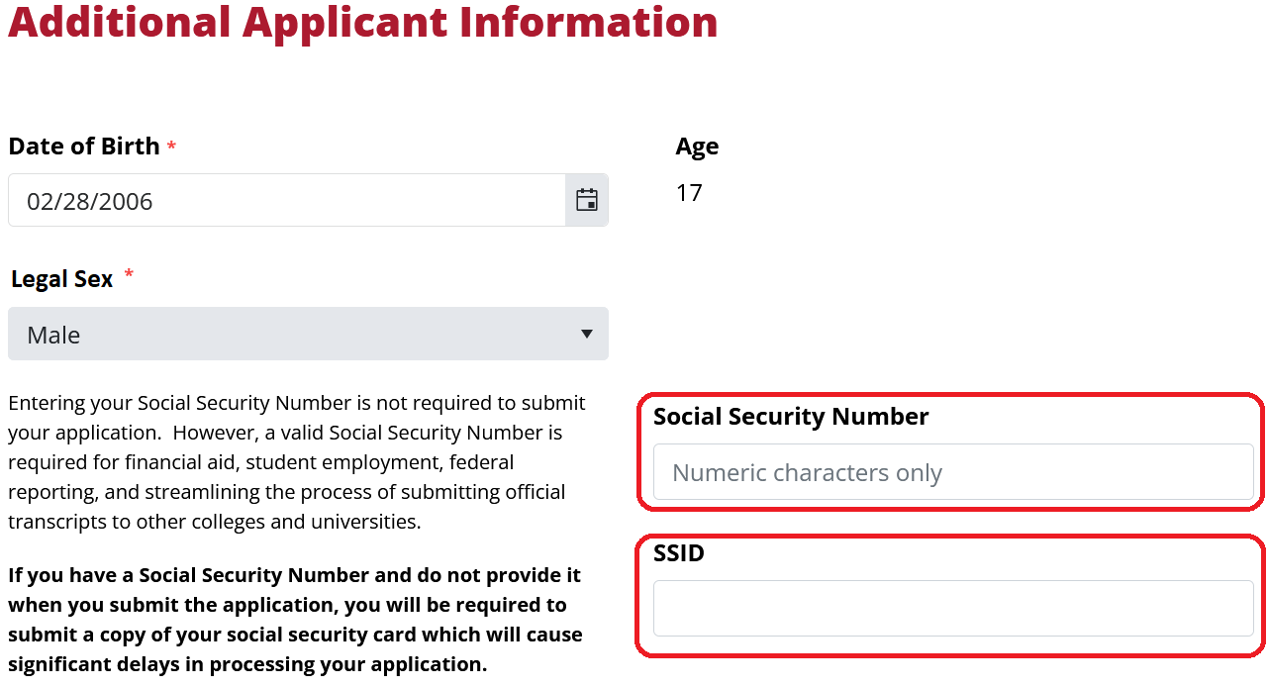
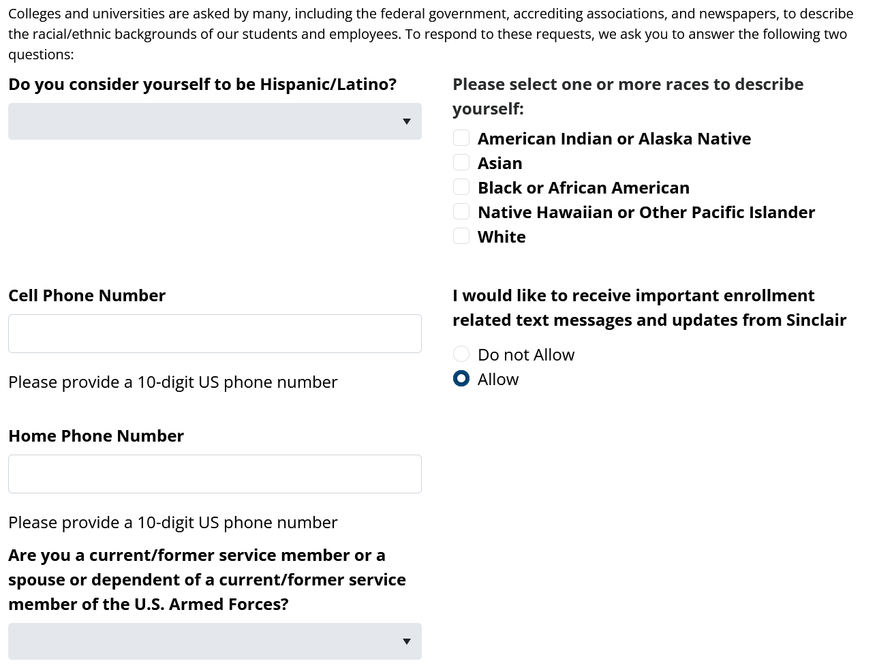
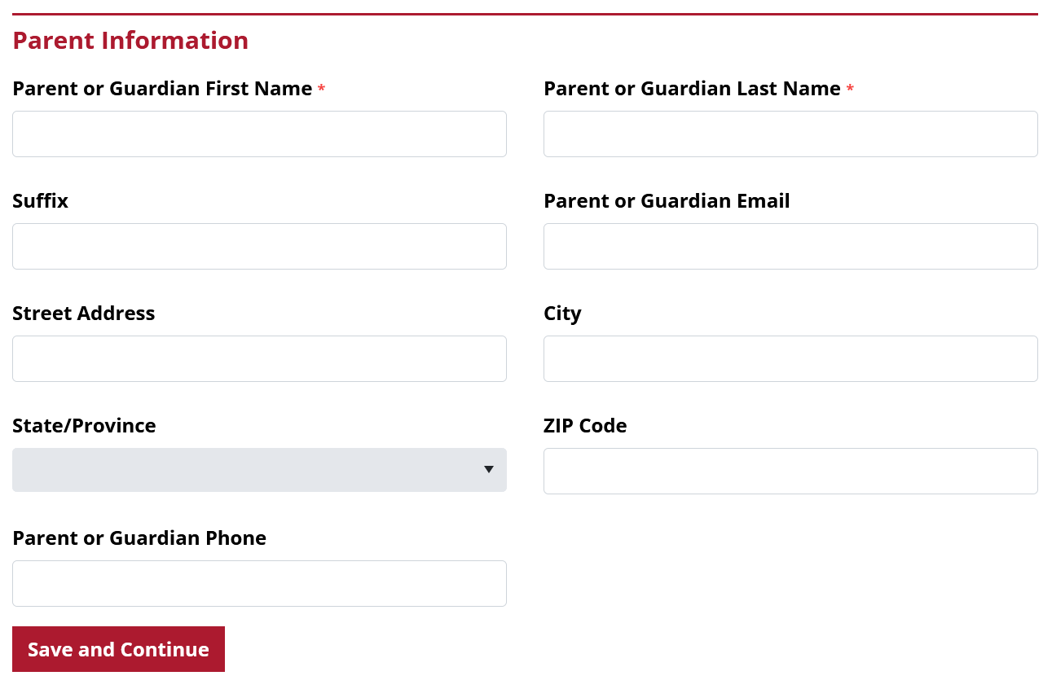
Enter your birthdate, legal sex (used on government forms), and other demographic information on this page.
A social security number is required to process your application. If you do not have it today, continue on for now, but do not submit your app yet. You will be able to log back in to finish later, once you have it. Students with an unassigned SSN: contact the Tech Prep Office.
*Only enter numbers, not dashes*
While not required for Sinclair, some schools require students to provide an SSID. Ask your teacher if unsure.
Click Save and Continue.

Slide 9
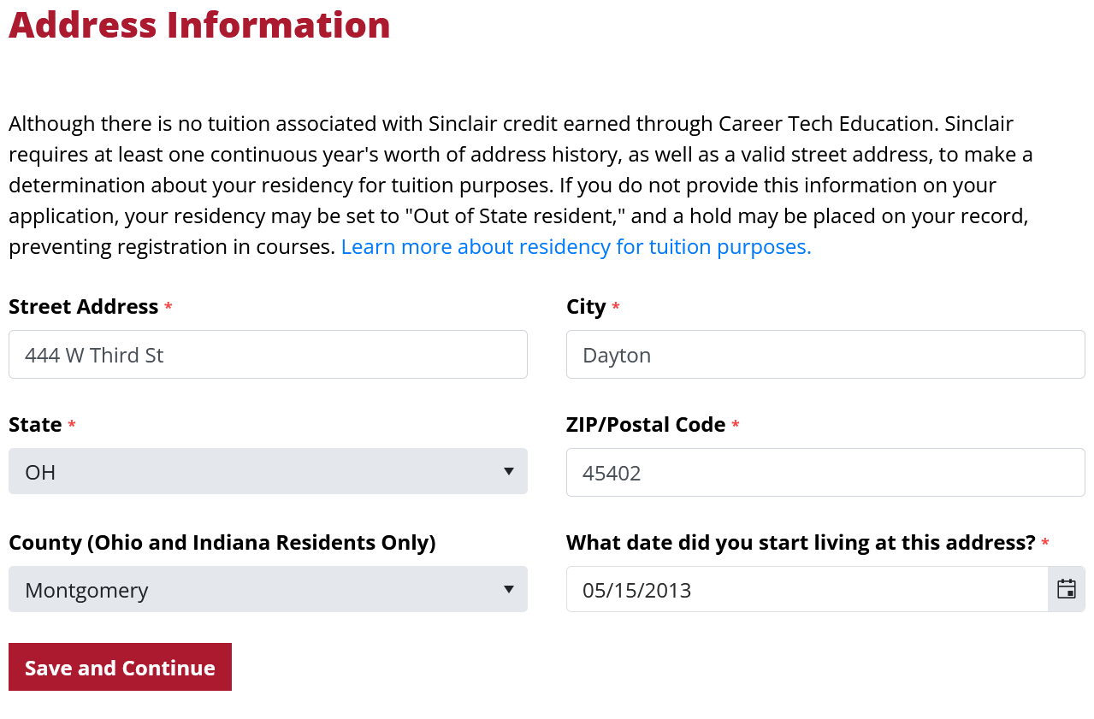
Enter your address information. (For best results, do not use your browser’s auto-fill feature.)
If you have lived at this address for less than one year, you will be asked to provide a previous address.
Click Save and Continue.

Slide 10
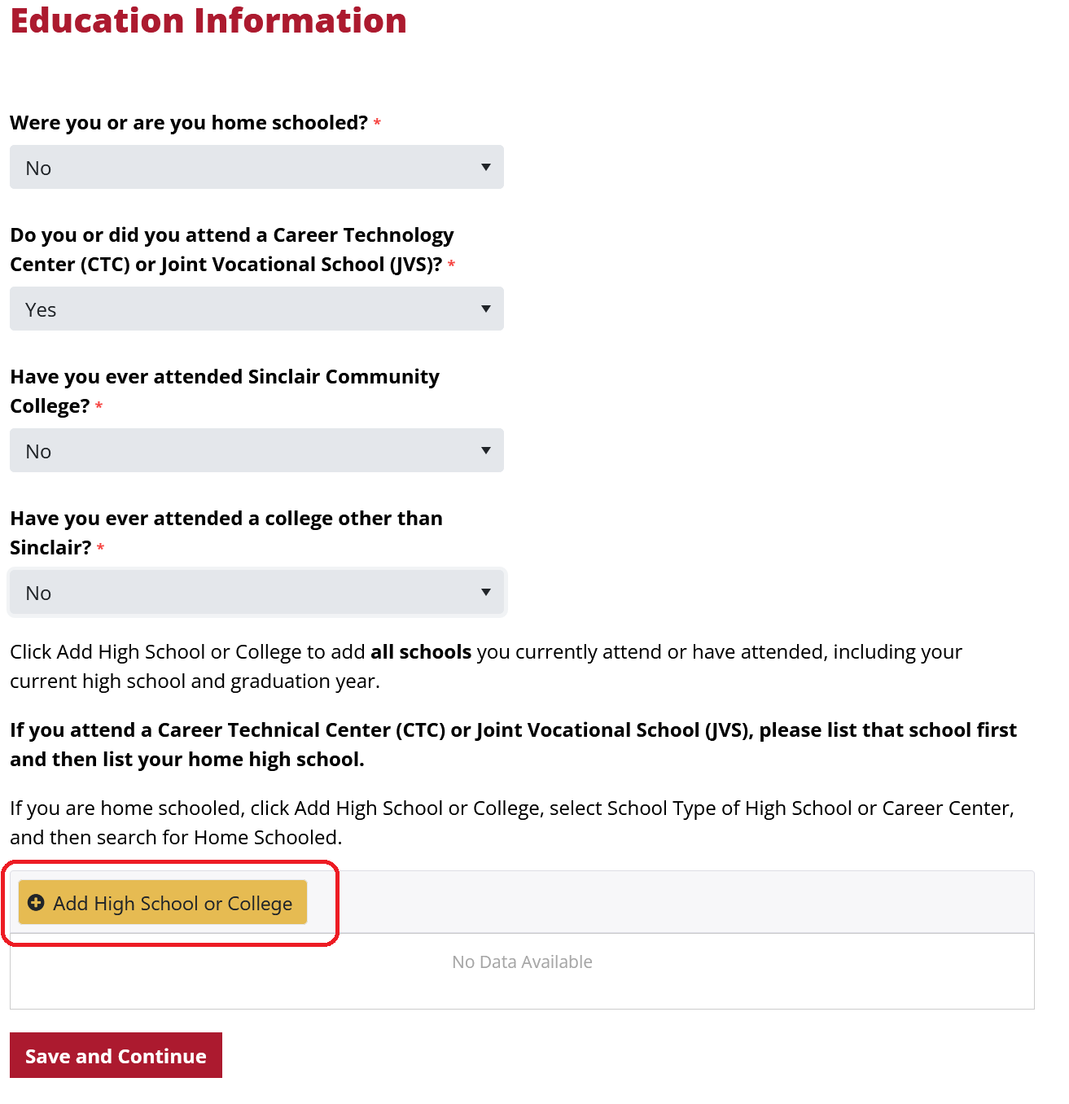
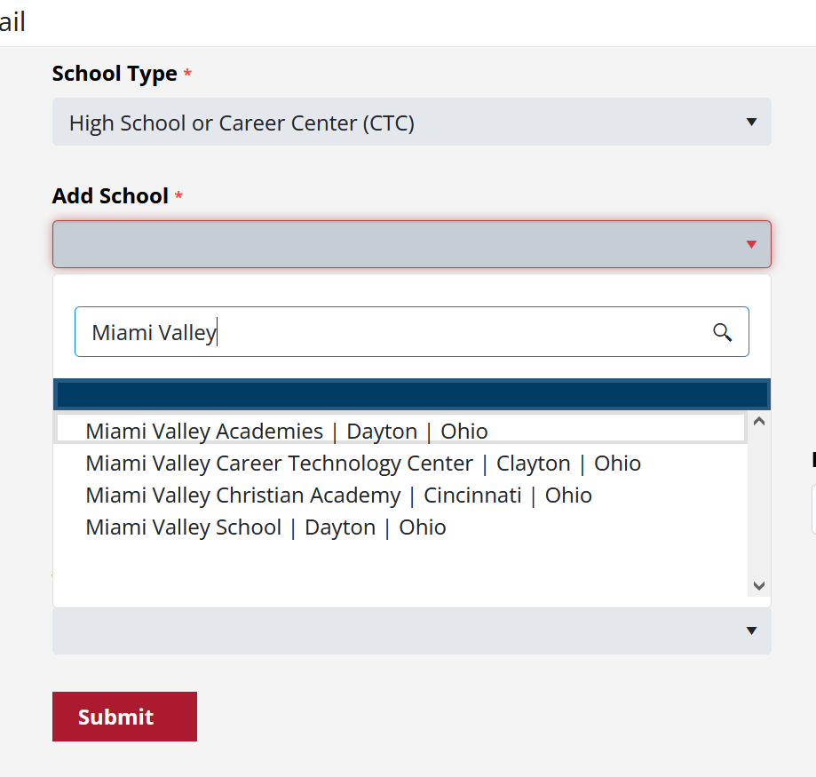
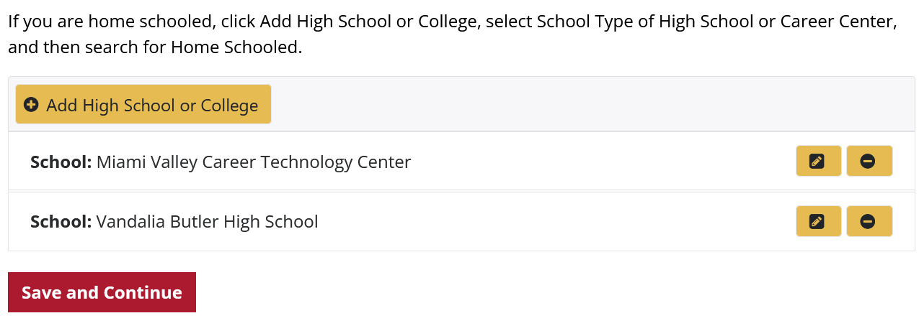
Enter your education information:
Do you attend a career tech center in addition to your home high school?
Have you attended any other college?
  Select Yes if you attend College Credit Plus at another college (Clark State, Edison, etc.)
Click Add High School or College.
Add your career tech center first, followed by your home school (from where you will earn your diploma)
Once you’ve added all schools, click Save and Continue.

Slide 11
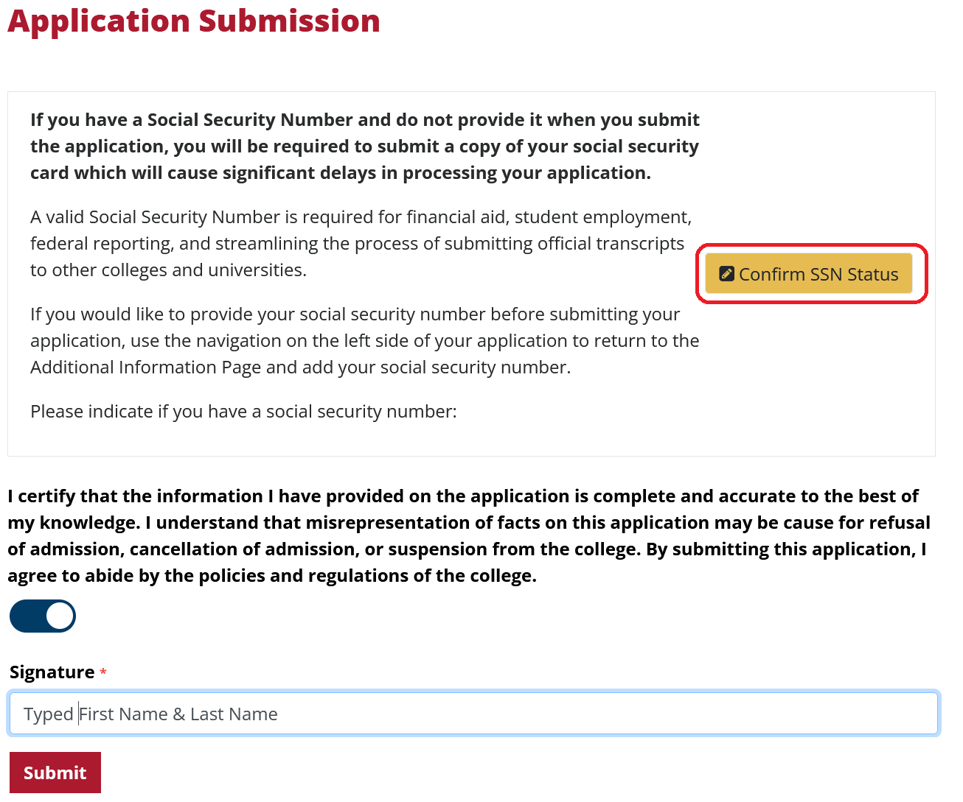
If you did not enter your social security number, stop here. Log out, write down your username and password, and return later to add it and submit.
If you did enter your social security number, certify, type your electronic signature, and click Submit.
Congratulations, you’re done!

Slide 12
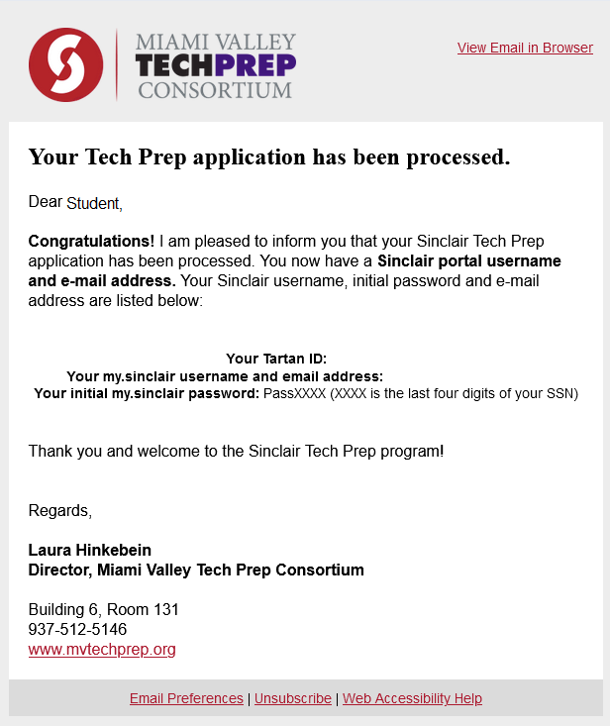
What’s next:
Once submitted, you will receive a confirmation email.
Within 1-5 business days, you will receive an email with your Sinclair login and password.

Slide 13


Thank you for completing the Sinclair Tech Prep Application!

